Slide 1
What is our solution?
Translate people Thoughts (ex: English) to Signs Language (ASL)

Slide 2
What is our solution?
Translate people Thoughts (ex: English) to Signs Language (ASL)
1:Speak Recognition

Slide 3
What is our solution?
Translate people Thoughts (ex: English) to Signs Language (ASL)
1:Speak Recognition
2.Module (Speak -> Sign)

Slide 4
What is our solution?
Translate people Thoughts (ex: English) to Signs Language (ASL)
1:Speak Recognition
2.Module (Speak -> Sign)
3.Preview the sign

Slide 5
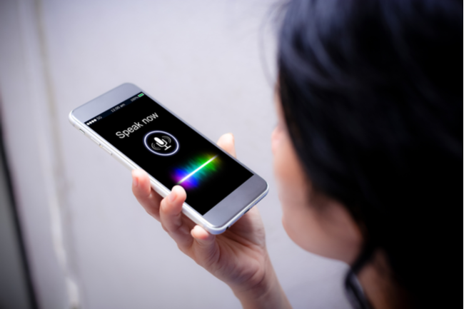
Speak Recognition
Embedded speak Recognition system in devices .

Slide 6
Module (Speak -> Sign)
We have Deferent Options:
1.Adding sign for each word manually (Dictionary)
2.Using Machine translation to translate sentences to sign

Slide 7
Module (Speak -> Sign)
Using Machine Translation to translate text to a sign representation
- Machine learning
Dataset
Auto mapping
pairs( sign representation (sign writing), sentences)
񌏁񍝁񀀒* \

Slide 8

Preview the sign
Use game engine to develop animation for each letter in sign writing

Slide 9
Where are we know?
Preparing Dataset
-sign representation (sign writing)
more then 5000 English words
more then 10 Dari words

Slide 10
Next Step?
Creating the module
-Train
-evaluate
-Test

